Slide 1

Thinking Like a Scientist
Tom Carpenter, PhD
Stephen Elston, PhD

Slide 2
Premise
Scientists: statistics and methodology to understand people
Very smart professionals answering research questions at Microsoft
Share how professional scientists approach problems for understanding human behavior
Notes:
Using data to predict and answer questions about people, behavior

Slide 3
Thinking Like a Scientist
Slides and Jupyter Notebooks:
Tom Carpenter, PhD
Stephen Elston, PhD
https://github.com/StephenElston/StatisticalMethodsForDataScience
See ThinkingLikeAScientist directory

Slide 4

Tom Carpenter, PhD
Associate Professor, Psychology @ Seattle Pacific U.
Research & Statistical Consultant Co-author of edX data science, ML courses
Notes:
Expertise:
Statistical modeling and computing
Research design and methodology
Human psychology (emotion, bias, consumer behavior)

Slide 5
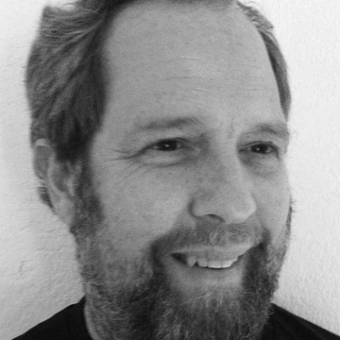
Stephen F. Elston, PhD
Principle Consultant, Founder at Quantia Analytics LLC
Instructor in data science, machine learning and AI at U. of Washington, Harvard Extension School
Co-author and maintainer of edX data science, ML and AI courses

